Slide 1

Ballarpur Institute of Technology
Department of Computer Science & Engineering
Presented by: Abhishek Ganvir | Atharva Thak | Nidhi Nirmal | Ganesh Kove
Under the Guidance of: Prof. Mehnaz Sheikh

Slide 2
Food Ingredient Health Analyzer
Using Machine-learning & NLP

Slide 3
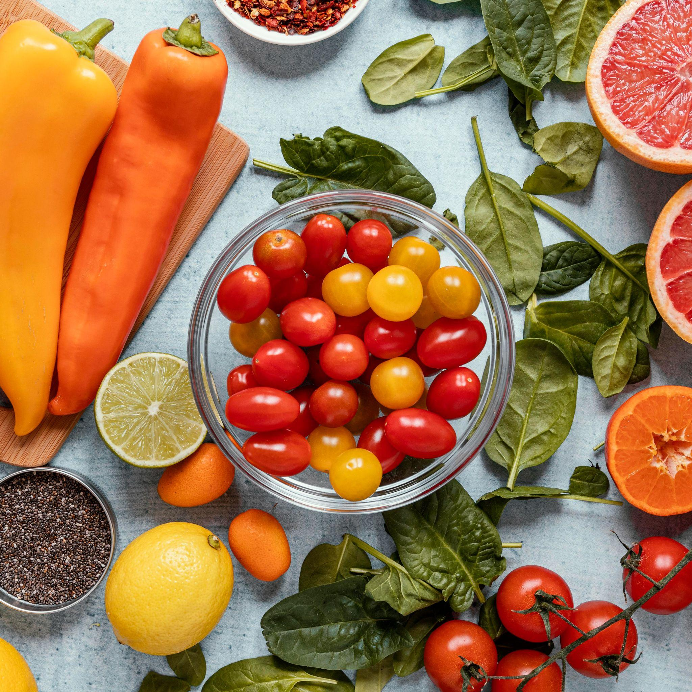
Introduction
Processed food consumption is increasing rapidly, making it difficult to quickly judge food quality and safety. this can help by analyzing ingredients and providing instant health insights.
Key Points:
Rising consumption of processed foods
Need for quick health evaluation
AI-based ingredient analysis
Predict health grade of food
Detect potential health risks

Slide 4
Methodology & Tech Stack
Data
Preprocessing
Feature Extraction
“Food ingredients dataset used for training and analysis of nutritional patterns”
“Text cleaning performed using Regex to remove noise and standardize data”
“TF-IDF Vectorizer used to convert textual data into numerical features"
Model
Backend & Libraries
Output
“Logistic Regression applied to predict the health grade of food items"
“Flask API for deployment; pandas, sklearn, and joblib for implementation"
“Generates a health grade and identifies potential risks in food products"

Slide 5
Research (Existing vs Our Work)
Existing Research:
Nutritional scoring systems (Nutri-Score)
ML in food classification
Ingredient-based health prediction
Our Work:
Real-time API based prediction
Risk word detection
Allergen identification

Slide 6
How it works?
Step 1
Step 2
Step 3
Step 4
User input ingredients
Text cleaning and preprocessing
TF-IDF converts test into numerical data
Model predict health grade A-E
Step 5
Step 6
Step 7
Step 8
Detect risks & allergens
Returns json response with explanation
Display results to user
Helps in better food decision

Slide 7


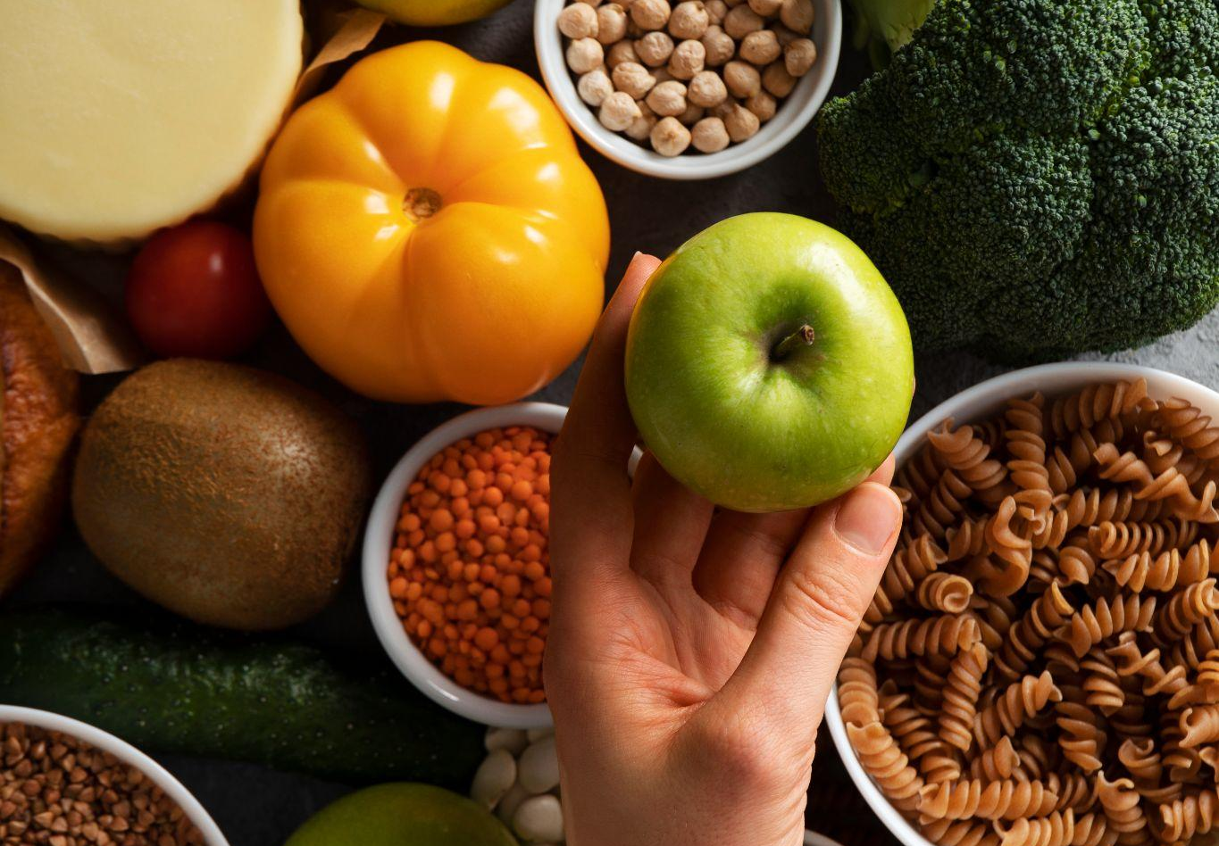
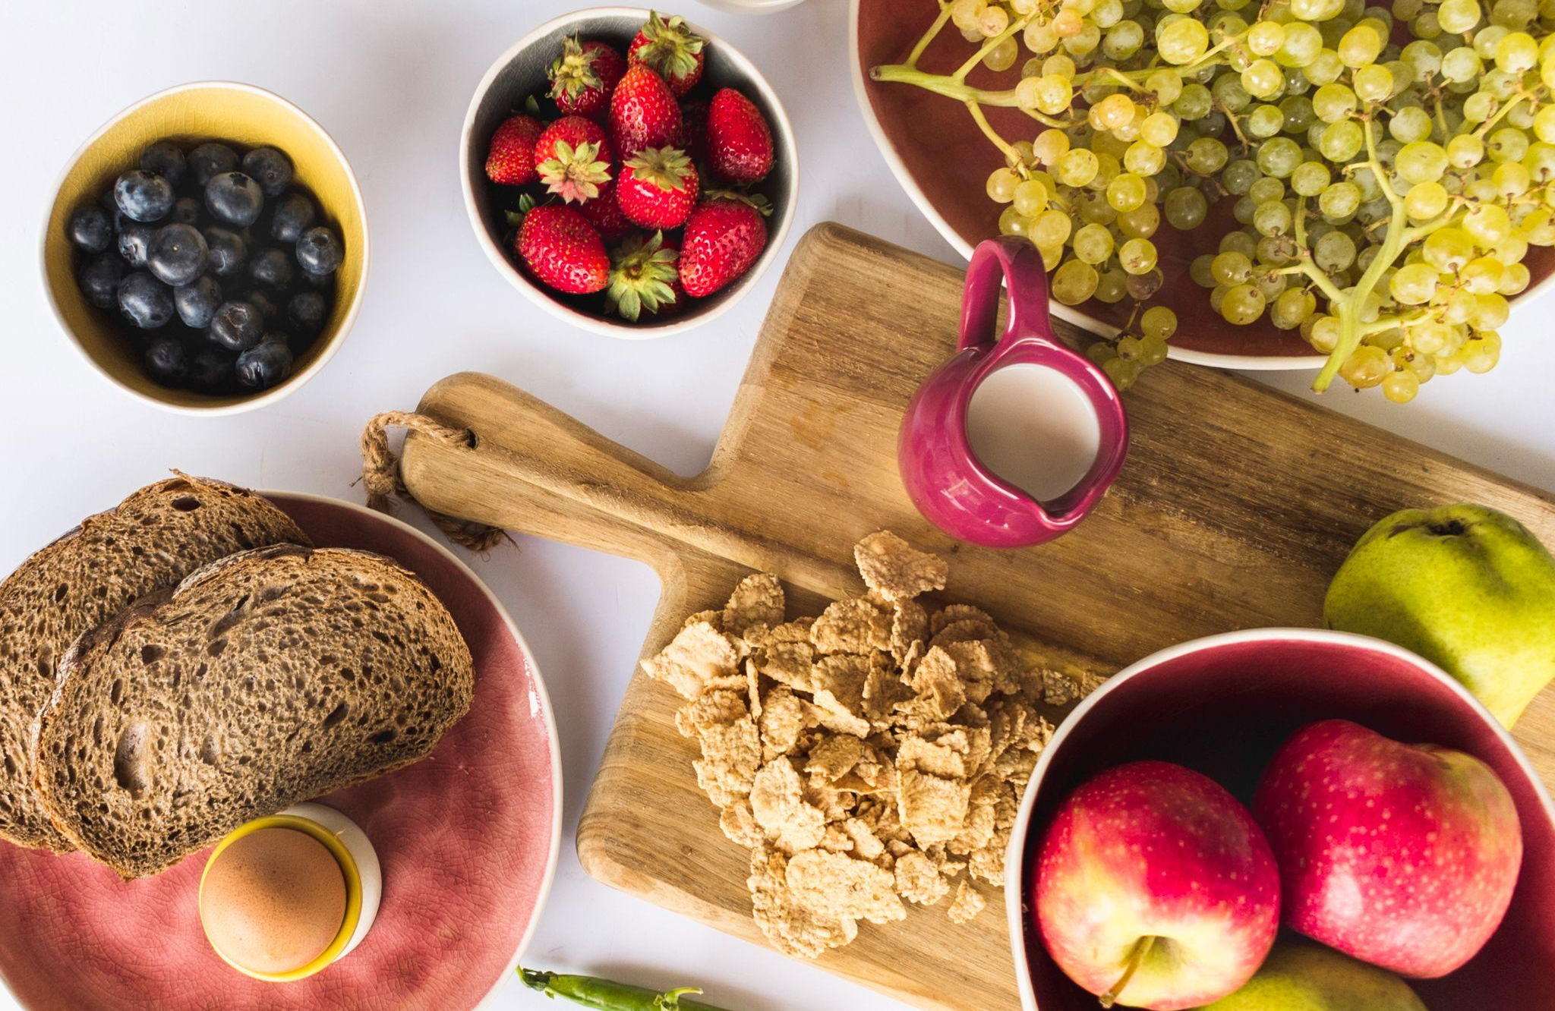
Conclusion
It simplifies food health analysis by making evaluation faster and more accessible. It helps users make better dietary choices and supports healthier lifestyles.

Slide 8
Thanks!
Do you have any questions?

